Slide 1


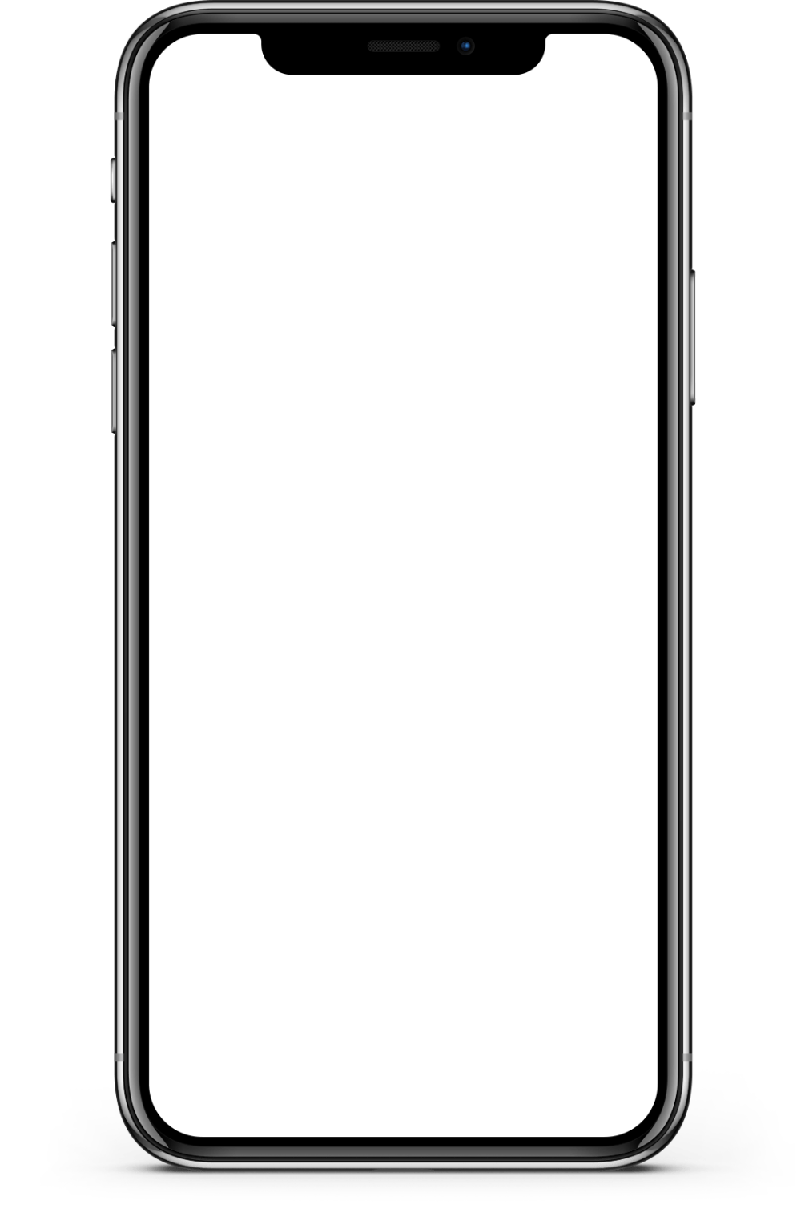
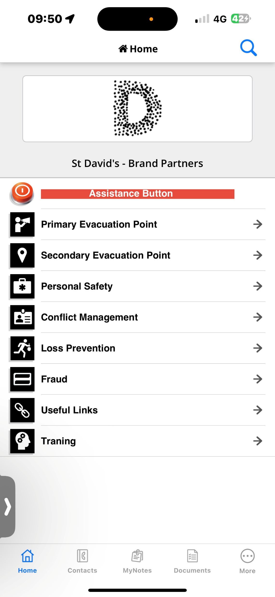

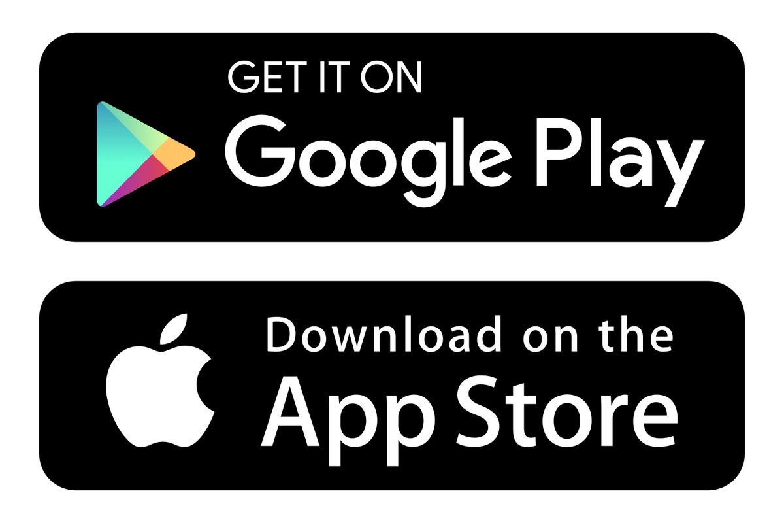
Brand Partner App
Take control of your safety
Receive Security Notifications
Know what to do in a crisis
Username
Search “URIM” on the Google Play/Apple App store to download
Password

